Slide 1


AnaIR: A Semi-Analytical Green’s
Function Inspired Neural Network for Static IR Drop Prediction
Shruti Pandey, Aneeket Yadav and Smruti. R. Sarangi
Indian Institute of Technology Delhi (IITD)
New Delhi, India
IEEE Computer Society Annual Symposium on VLSI (ISVLSI), 2025

Slide 2
Motivation
High IR drop in advanced technology nodes
Leads to functional failures and yield loss.
Traditional IR drop simulation is computationally expensive and slow.
Drawbacks of the existing ML-based IR drop predictors
Unaware of the underlying physics of the IR drop simulation
and highly inaccurate.
Extensive feature engineering to embed circuit features.
Require complex neural networks and large datasets.

Slide 3
Background
Green’s function: the impulse response (IR drop profile) of
a unit power source.
Solves equations of the form $L(f\left(x\right))=q\left(x\right)$ and is given by $L(g\left(x\right))=δ\left(x\right)$.
Solves equations of the form 𝐿(𝑓(𝑥))=𝑞(𝑥) and is given by 𝐿(𝑔(𝑥))=𝛿(𝑥).
$$L\left(g\left(x\right)⋆q\left(x\right)\right)=L\left(g\left(x\right)\right)⋆q\left(x\right)= δ\left(x\right)⋆q\left(x\right)=q(x)$$
𝐿(𝑔(𝑥)⋆𝑞(𝑥))=𝐿(𝑔(𝑥))⋆𝑞(𝑥)= 𝛿(𝑥)⋆𝑞(𝑥)=𝑞(𝑥)
$L$: Linear partial differential operator, $δ\left(x\right):$ $\text{Dirac} \text{delta} \text{function}$.
𝐿: Linear partial differential operator, δ(𝑥): "Dirac delta function".

Slide 4




Overview of the Contributions
Aim: Accurate and faster ML-based IR drop prediction with Green’s functions
We are the first to propose Green’s functions-based IR drop simulation
Convolution
Estimate IR drop using Green’s functions
AnaIR: Neural Network
Initialized with the
Green’s function
Enhances accuracy and
deals with the rim effects
Accurate
IR drop
map
Power
map
Masking with the layout map
Removes sparsity
Embeds intrinsic properties of the power grid
Very fast
Eliminates the need for large datasets and extensive feature engineering

Slide 5
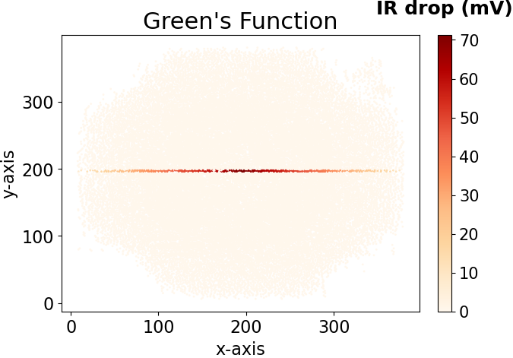
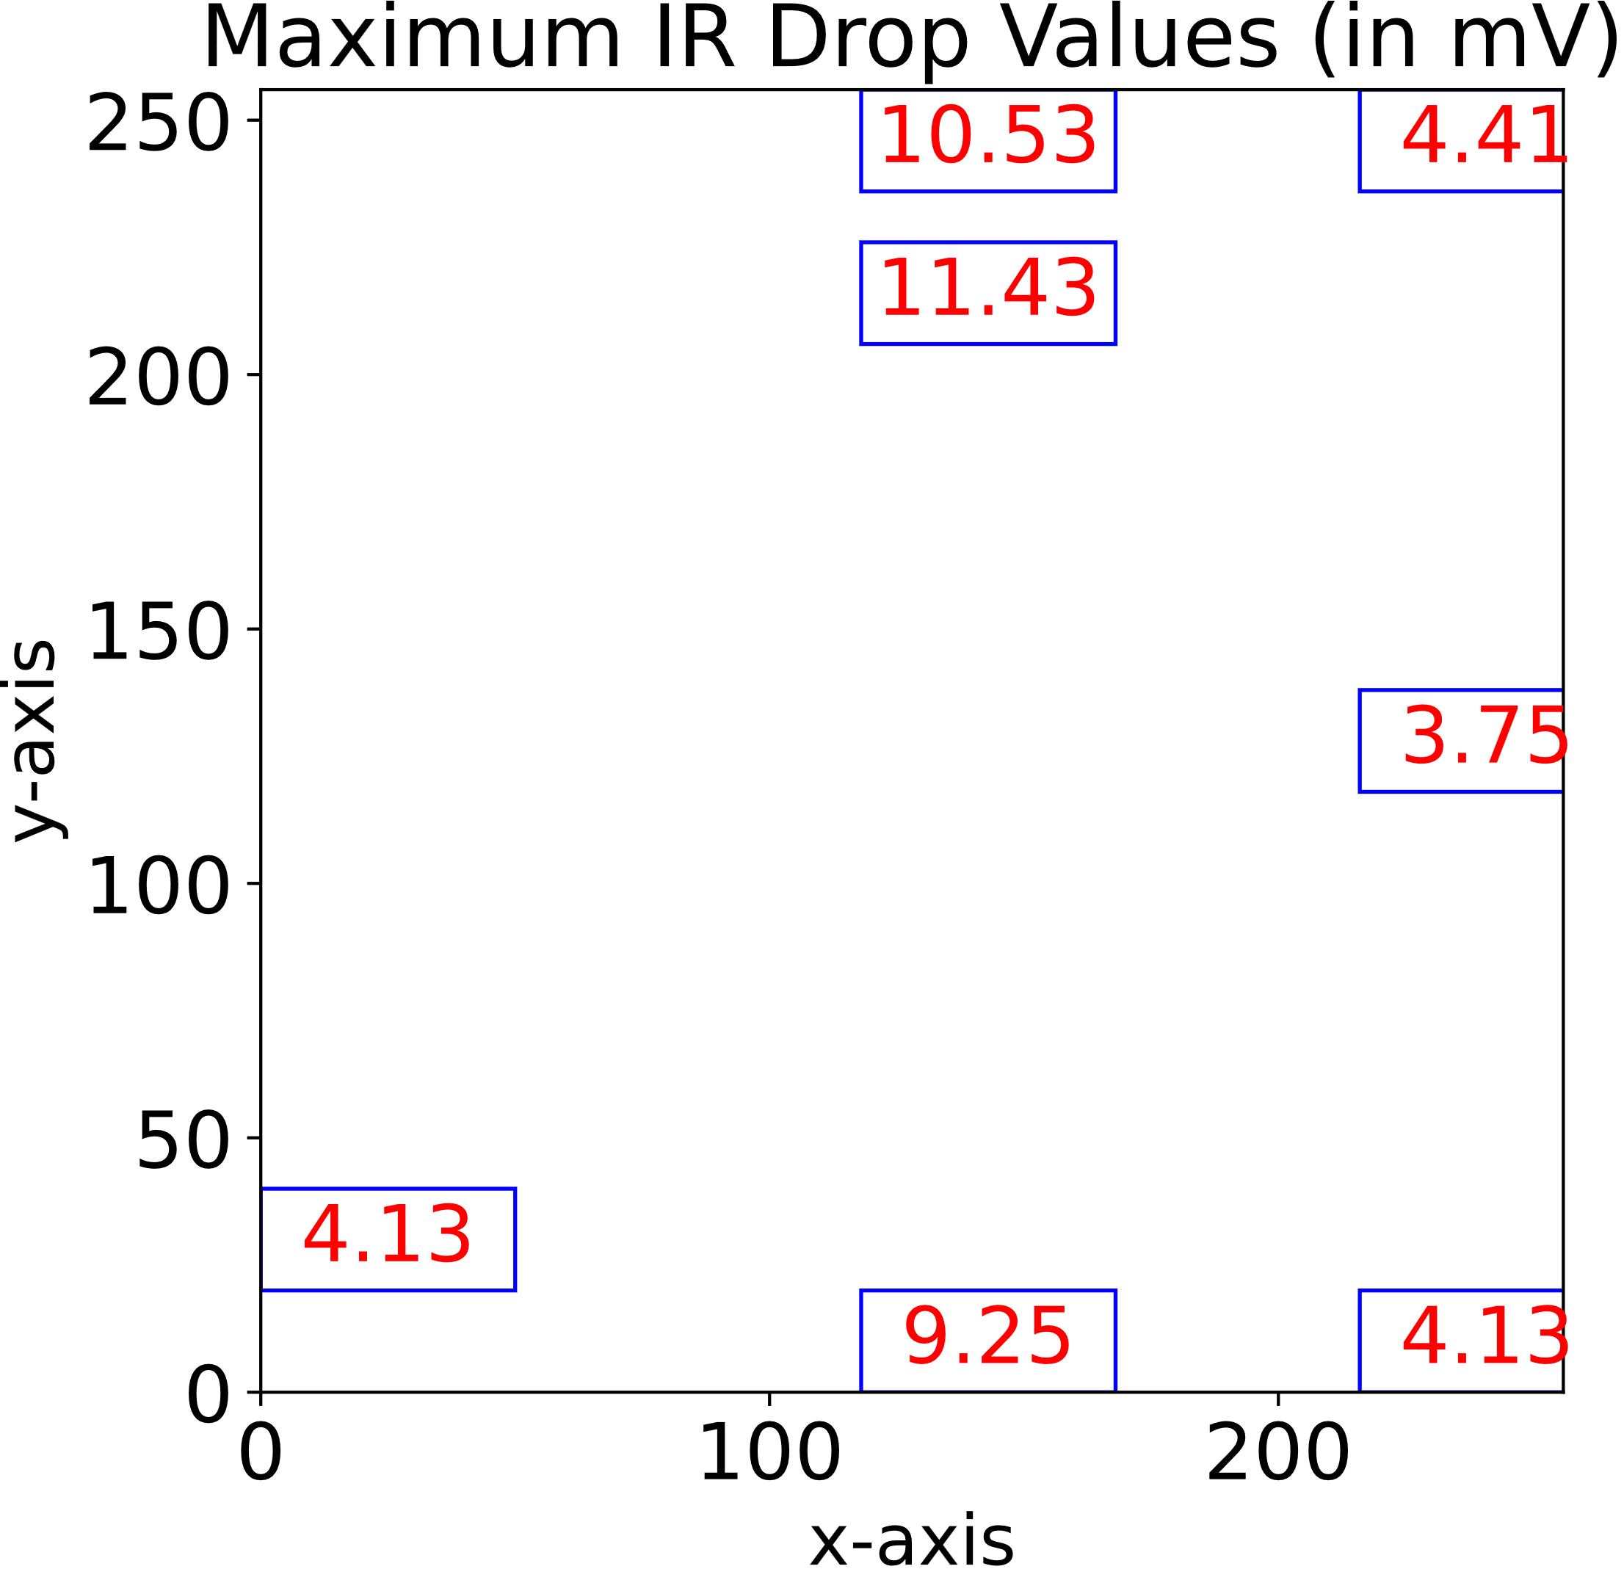
Proposed Solution
The empirically derived Green’s function follows the superposition principle and is shift-invariant in broadly the central region of the chip.
Variation of the IR drop values at the rim of the chip

Slide 6
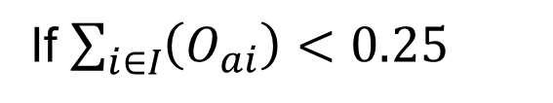
Proposed Solution
Divide the circuit into tiles of size $w_{t}× h_{t}$, each tile represents a feature (power/IR drop) value.
Divide the circuit into tiles of size 𝑤_𝑡× ℎ_𝑡, each tile represents a feature (power/IR drop) value.
Power value of a tile in power map $M_{p}$:
$M_{p,tile }$= $\sum_{i∈I}{\left(O_{ai}×P_{i}\right)}$
Power value of a tile in power map 𝑀_𝑝:
𝑀_(𝑝,𝑡𝑖𝑙𝑒 )= ∑_(𝑖∈𝐼)▒(𝑂_𝑎𝑖×𝑃_𝑖 )
$I:$ set of standard cell instances that fall within the tile,
𝐼: set of standard cell instances that fall within the tile,
$O_{ai}:$ Overlap ratio, computed as $\frac{{Area}_{overlap}}{{Area}_{tile}}$,
𝑂_𝑎𝑖: Overlap ratio, computed as 〖𝐴𝑟𝑒𝑎〗_𝑜𝑣𝑒𝑟𝑙𝑎𝑝/〖𝐴𝑟𝑒𝑎〗_𝑡𝑖𝑙𝑒 ,
Note: Replace p with IR for IR drop map.
$P_{i}$ is the power value of instance $i.$
𝑃_𝑖 is the power value of instance 𝑖.
Layout Mask “$M_{d}$”:$M_{d,tile }= \left\{\begin{aligned}0 \\ 1\end{aligned}\right.$
Layout Mask “𝑴_𝒅”: 𝑀_(𝑑,𝑡𝑖𝑙𝑒 )= {█(0 @1)┤
If $\sum_{i∈I}{\left(O_{ai}\right)}<0.25$
Otherwise

Slide 7
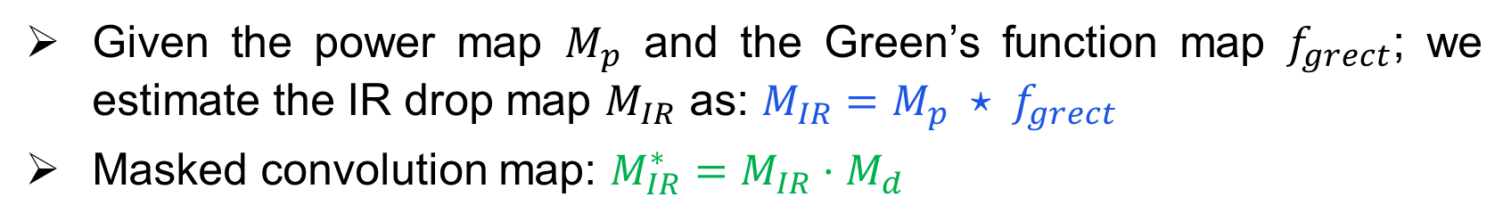
Proposed solution
Given the power map $M_{p}$ and the Green’s function map $f_{grect}$; we estimate the IR drop map $M_{IR}$ as: $M_{IR}=M_{p} ⋆ f_{grect}$
Masked convolution map: $M_{IR}^{∗}=M_{IR}⋅M_{d}$
Convolution
Layout-mask
Table 1: Details of the circuits used in our experiments
Circuits | aes_256 | LinkRunCCA | Cordic | Keccak | fa32_array
#Std. cell instances | 3,25,359 | 54,871 | 3,479 | 25,963 | 27,107
#Pixels | 732x732 | 463x463 | 117x117 | 256x256 | 204x204

Slide 8
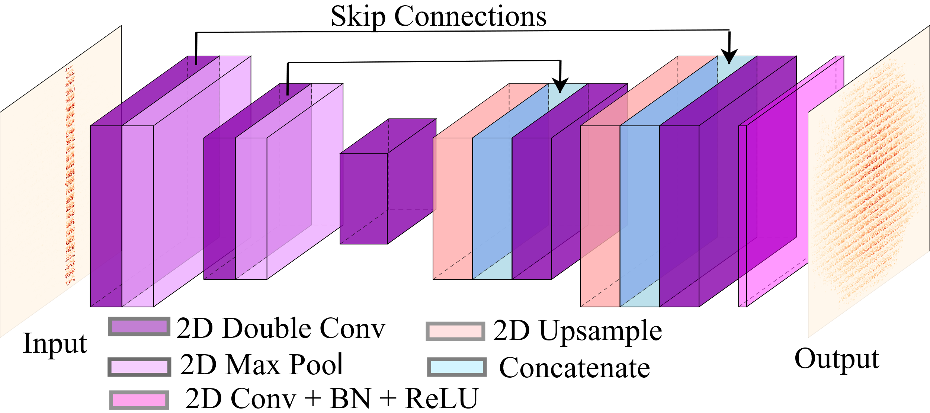
Proposed solution
Masked convolution map
Predicted IR-drop map
AnaIR: An encoder-decoder based network embedded with the
Green’s function

Slide 9
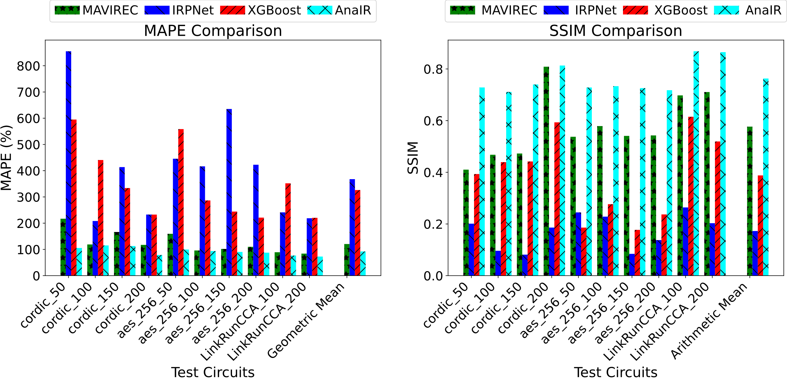
Results
AnaIR improves
accuracy by 32.6%
AnaIR improves
the SSIM by 33.3%
MAPE* and SSIM* for the test circuits
* MAPE: Mean Absolute Percentage Error, SSIM: Structural Similarity

Slide 10
Results
Comparison of AnaIR with the existing ML-based IR drop predictors (all results w.r.t. the commercial IR drop simulator)
Metrics/ Methods | IRPNet | MAVIREC | XGBoost | Convolution | Convolution + Masking | AnaIR
MAPE (%) ↓ | 409 | 125.9 | 348.4 | 286.73 | 203.4 | 93.25
SSIM ↑ | 0.17 | 0.57 | 0.38 | 0.14 | 0.28 | 0.76
Inference Time (ms) ↓ | 25.82 | 161.92 | 101 | 2.9 | 3.06 | 41.5
AnaIR is 3.9 times faster than the nearest competing work.
Masking of the convolved map reduces the error by 83.3% and doubles the SSIM.

Slide 11
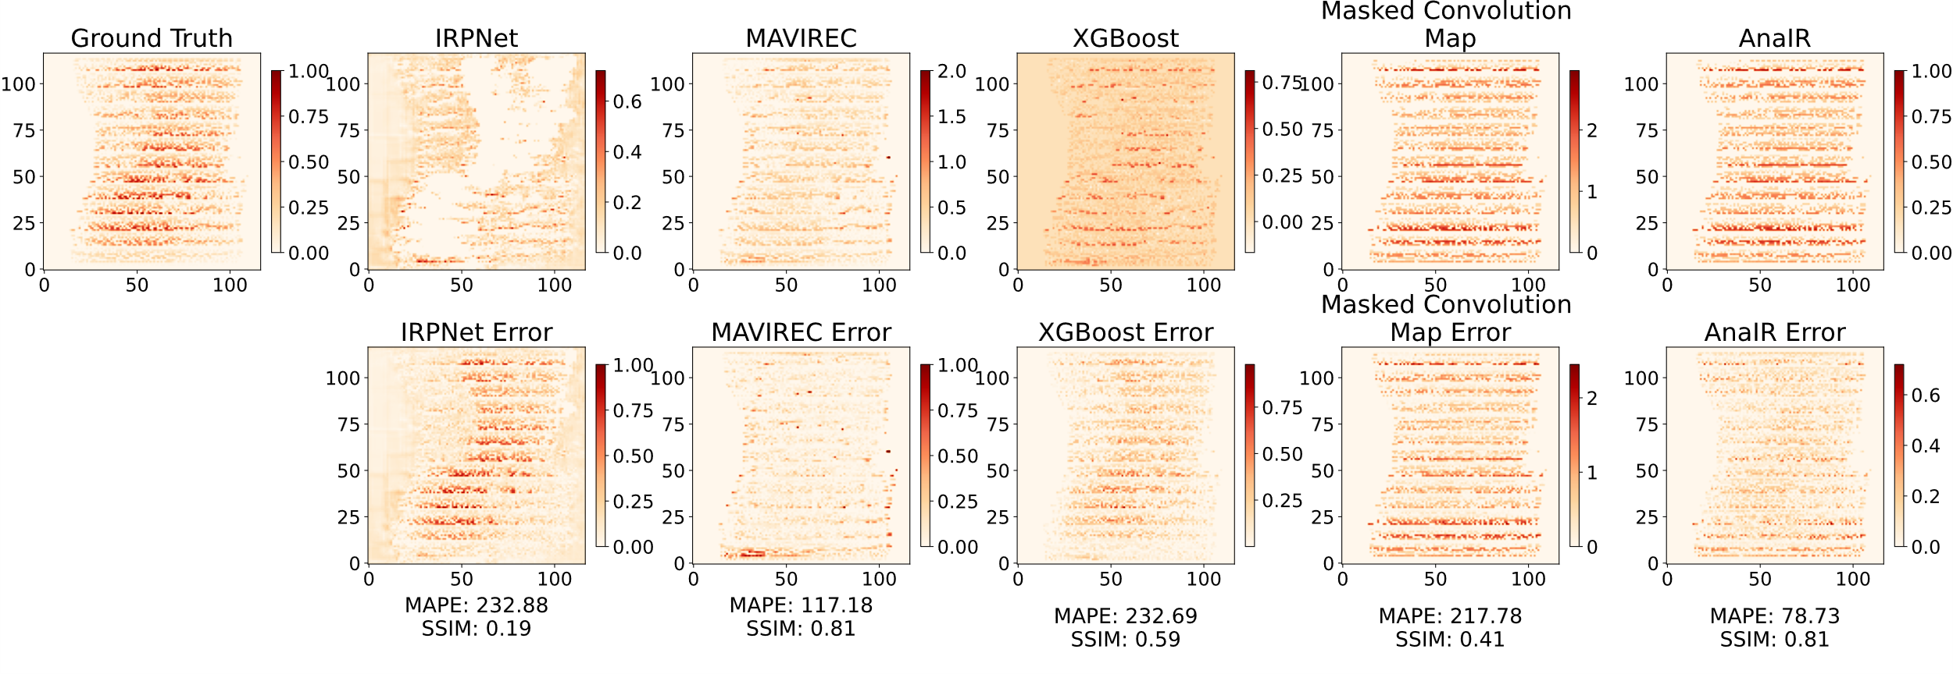
Results
Visual Comparison of AnaIR’s prediction with the existing ML-based predictors for the Cordic circuit

Slide 12



Conclusion
A semi-analytical Green’s function-inspired neural network AnaIR
for static IR drop prediction.
AnaIR embeds the underlying physics of the IR drop simulation through the Green’s function.
It improves both the accuracy and speed of the existing ML-based IR drop predictors.
It works for circuits of any size.

Slide 13


THANK YOU
Contact:
shruti.pandey@ee.iitd.ac.in
Questions

